Slide 1
Heritage Woods Commencement 2022

Slide 2
Simon Fraser University arrive at 1:00pm for check-in Ceremony starts 2:00pm sharp

Slide 3
*Parking is free in the north lot *You need to be in your Cap and Gown *head to the Halpern Centre to check at 1pm

Slide 4
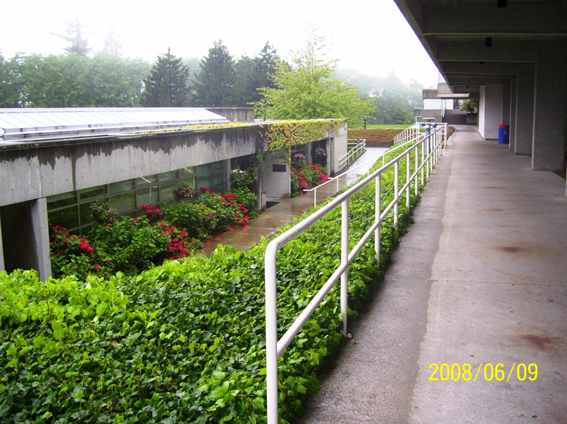
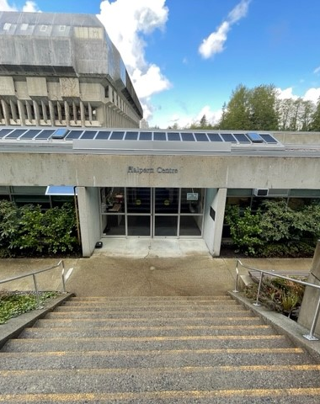
Check-in at the Halpern Centre at 1:00pm You’ll get a card with your name and a number. This will be handed to your counsellor before you cross the stage.

Slide 5
You’ll get a card with your name and a number. This will be handed to your counsellor before you cross the stage. Don’t lose it.
Once you have your card, proceed into the Quad (directly across from Halpern).
Einstein, Albert
76

Slide 6
You will line up in numerical order forming two lines (1-170, 171-340). Staff will be there to help. You Must stay in this order from here on out.

Slide 7
Check your number to make sure you are in order.
149

Slide 8
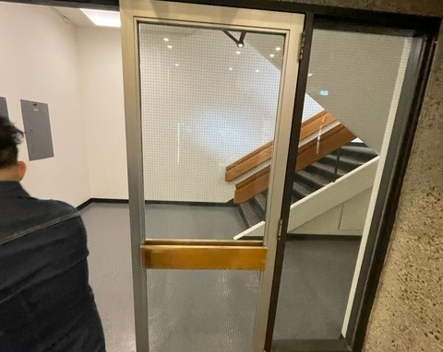
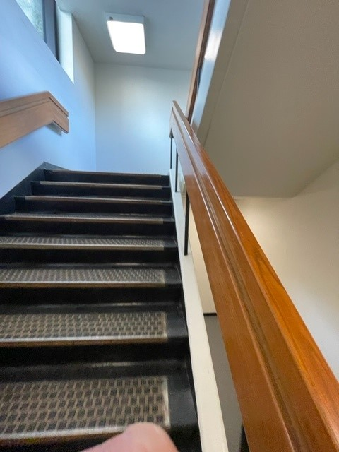
Getting to the stage area you will be led by a piper, a teacher and Valedictorians down a corridor and up some stairs.

Slide 9
You then walk outside to an assembly area ready to go at 2:00pm for the processional.

Slide 10
The bagpiper will start playing and lead the way. He’ll be followed by the two valedictorians then the grad class walking in two rows down the stairs to the seating area.

Slide 11
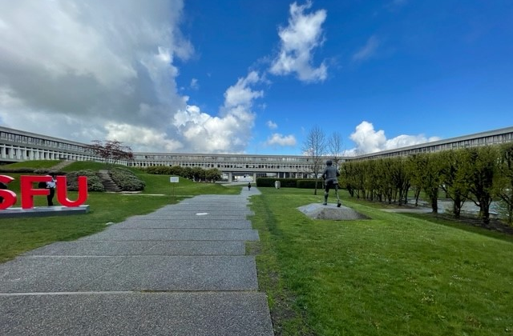
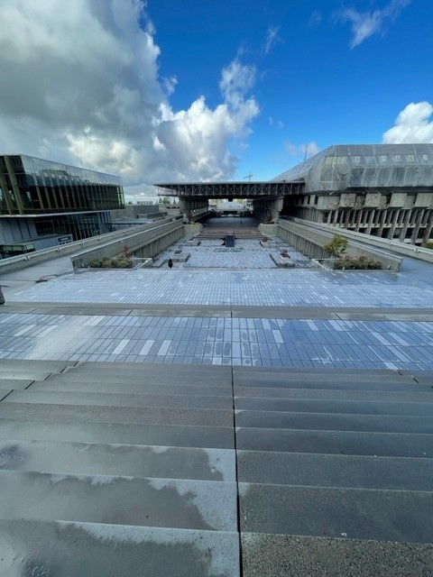
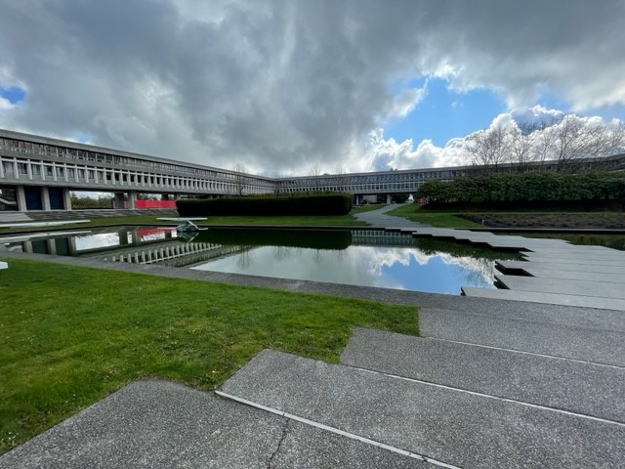

Slide 12
Your parents will be looking up at you from Convocation Mall, and You’ll head down the stairs.
It is really important for you to stay together…
no big spaces or it looks funny from below!

Slide 13
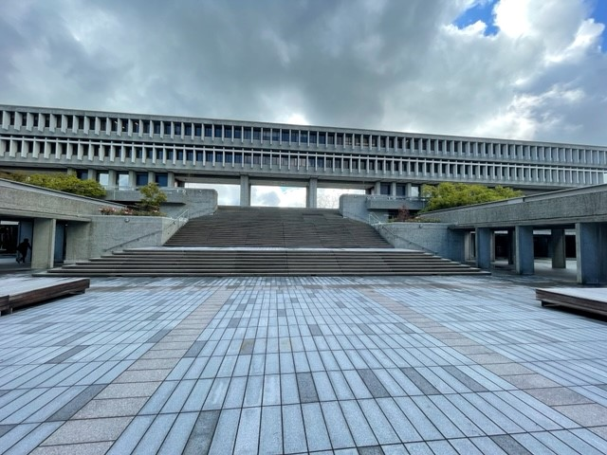
Hold up your gown as you head down the stairs.
Note how far you have to walk—choose your shoes wisely!!!

Slide 15
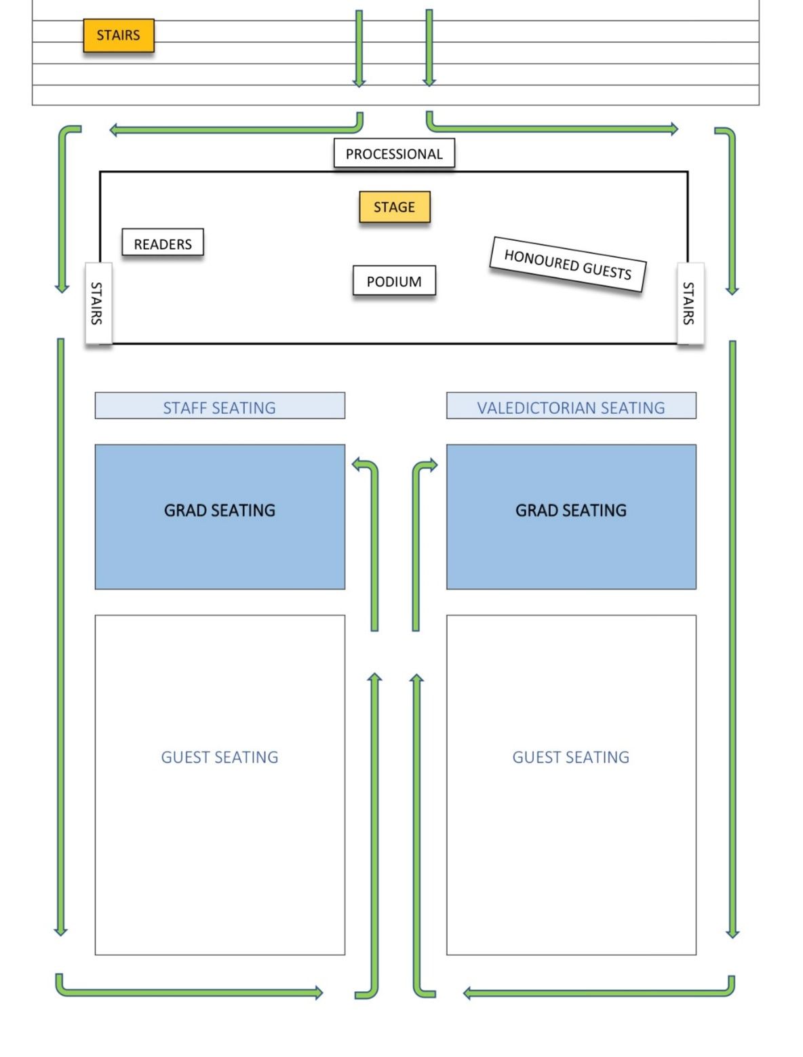
GETTING TO YOUR SEATS.

Slide 16
Acknowledgement of Territories and National Anthem. Please face the Canadian Flag on stage and remain standing

Slide 17
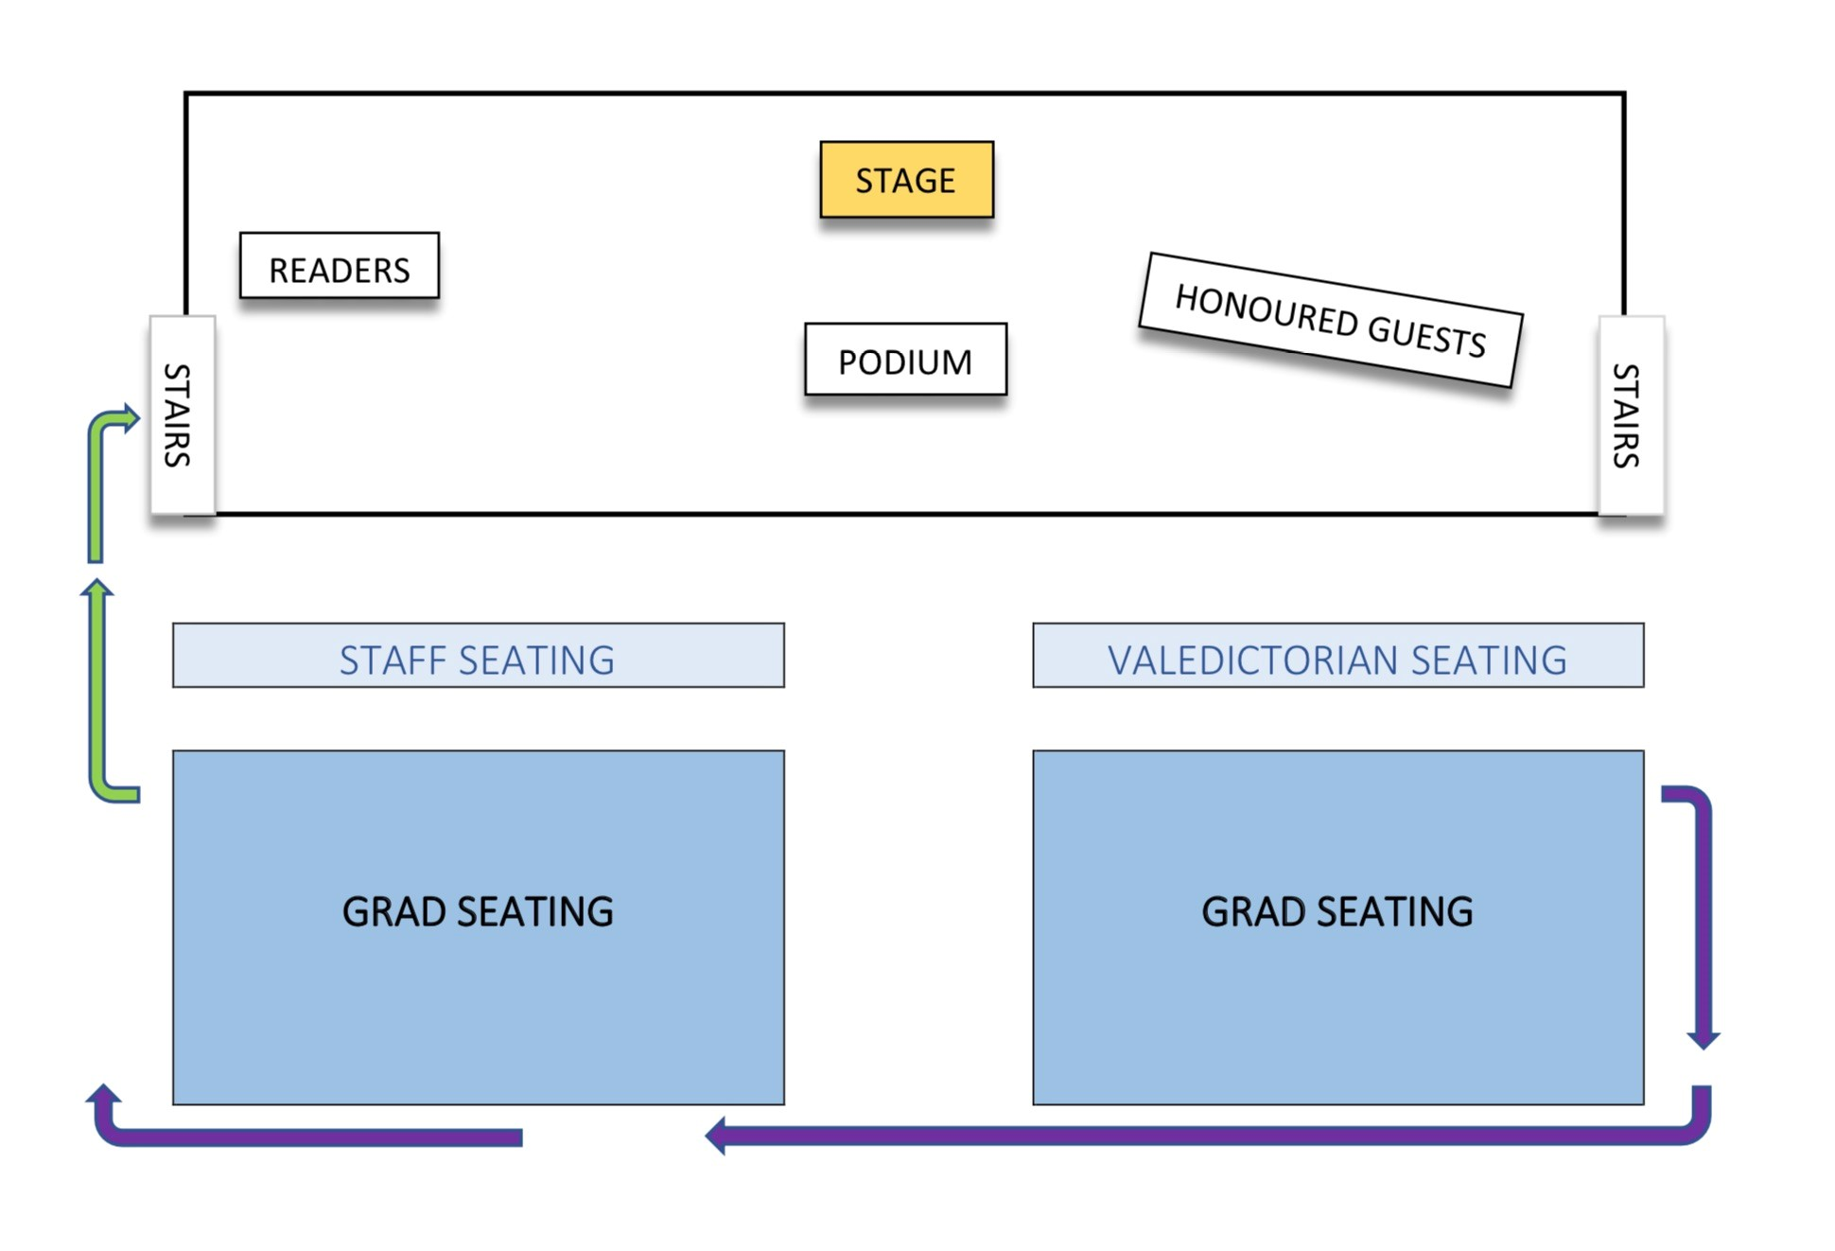
When it comes time to cross the stage, have your name card ready.
You will be directed out of your seat by a teacher and lined up to go up the ramp.

Slide 18
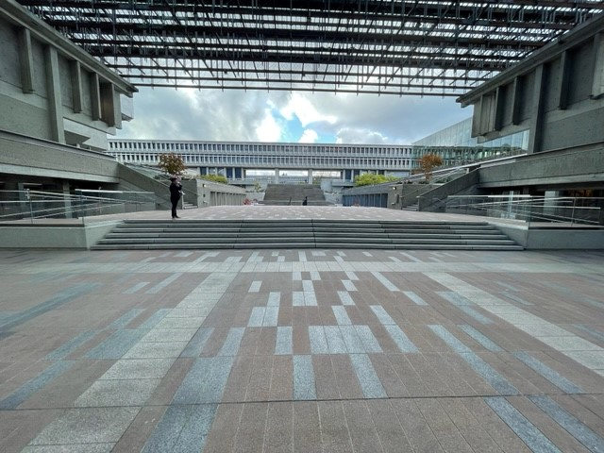
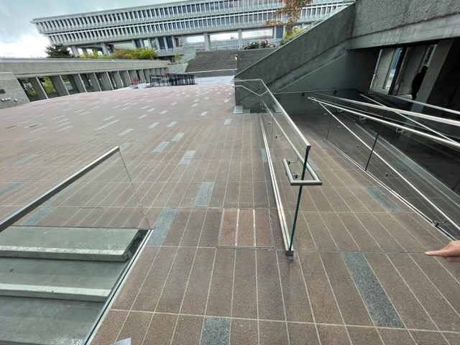
As you go up the ramp, hand your card to your counsellor.

Slide 19
You will be crossing the stage from left to right. First going to your VP to get a folder and a handshake, then to Mr. Clerkson for a photo op.

Slide 20
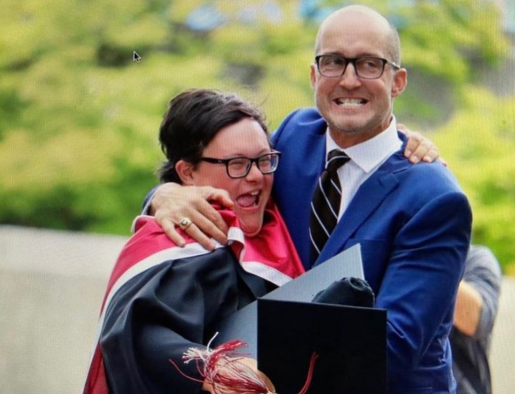
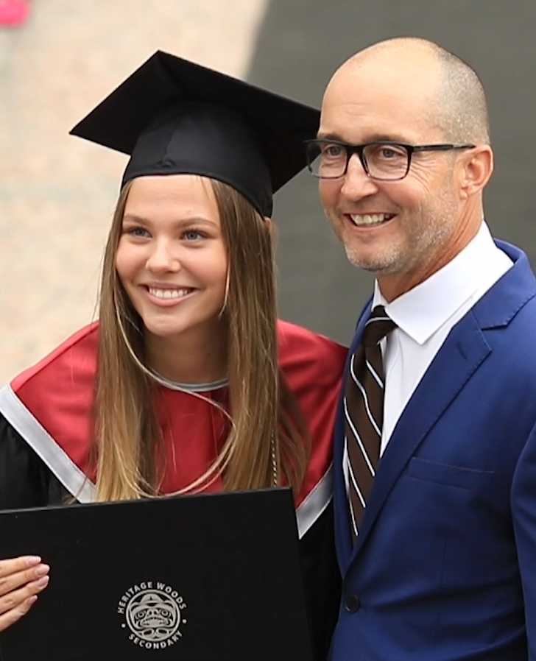
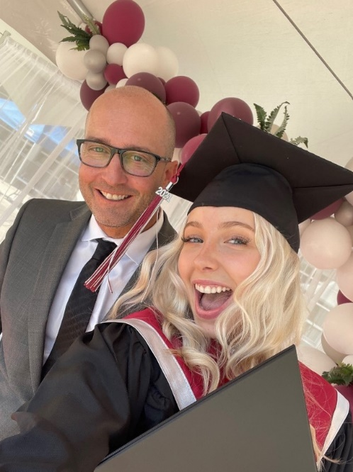
Mr. Clerkson will shake your hand and have a picture taken with you. **Tassle on your right**

Slide 21
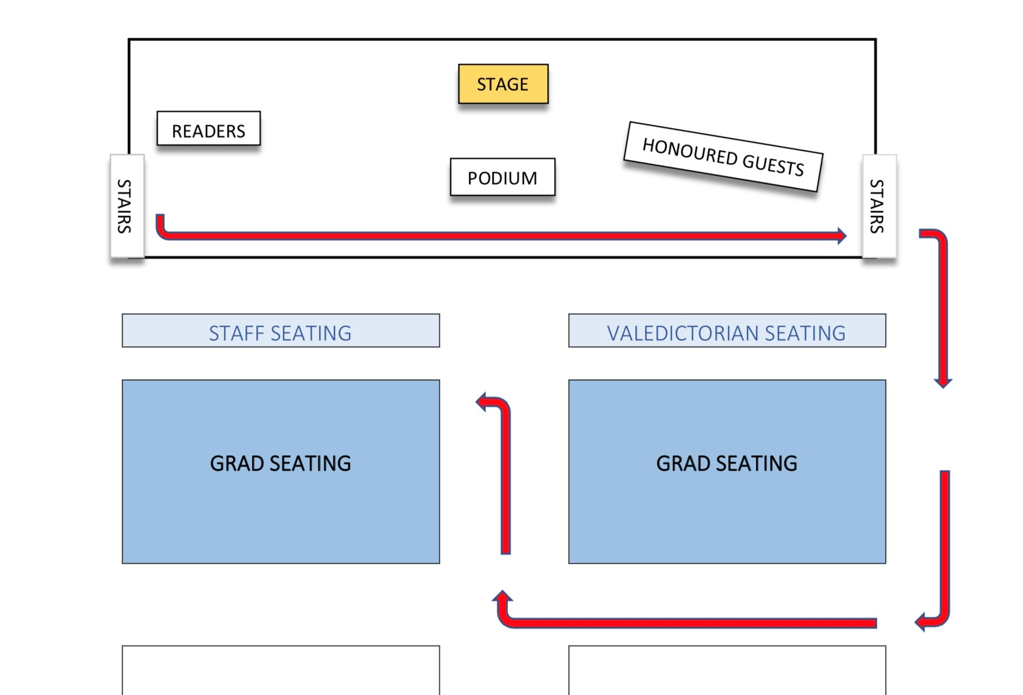

Slide 22
There will be speeches and entertainment. Be prepared to sit and stay to the end.

Slide 23
Hat Toss Count Down!!

Slide 24
Don’t worry if you lose your cap. Put your name on the inside of the cap when you receive it and we will get it back to you after the group photo.

Slide 25
When it is all over, Please follow direction to leave convocation mall to the stairs behind the stage for a group photo.

Slide 26
Please stay on the stairs until photos are taken.

Slide 27
Remember to thank your guests

Slide 28
Congratulations Kodiaks!

